Slide 1
Linear Algebra
Scalars, Vectors, and Matrices

Slide 2
Outline
Definitions
Examples
Vectors in space

Slide 3


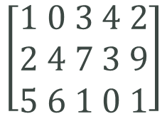
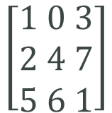
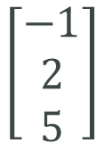
Definitions
Scalar: a constant
Vector: a single row or column of numbers
Matrix: a rectangular collection of numbers
$$3, 8, −5$$
$$\left[\begin{aligned}−1 \\ 2 \\ 5\end{aligned}\right]$$
$$\left[−1 2 5\right]$$
$$\left[\begin{aligned}1 0 3 \\ 2 4 7 \\ 5 6 1\end{aligned}\right]$$
$$\left[\begin{aligned}1 0 3 4 2 \\ 2 4 7 3 9 \\ 5 6 1 0 1\end{aligned}\right]$$

Slide 4
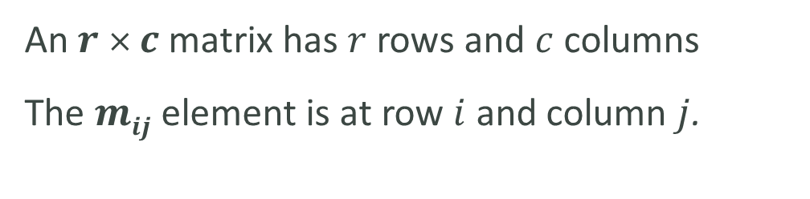
Dimensions
The dimensions of a matrix refer to the number of rows and columns
An $r$ × $c$ matrix has $r$ rows and $c$ columns
The $mij$ element is at row $i$ and column $j$.

Slide 5

Examples
1. What are the dimensions of each matrix?
$$A=\left[\begin{matrix}3.6 & 0.01 & 2.1 \\ 5.46 & 0 & 1.6\end{matrix}\right]$$
$$B= \left[\begin{matrix}e^{x} & x \\ e^{2x} & x^{3}\end{matrix}\right]$$
$$C= \left[c_{1} c_{2} c_{3}\right]$$
2 x 3
2 x 2
1 x 3

Slide 6
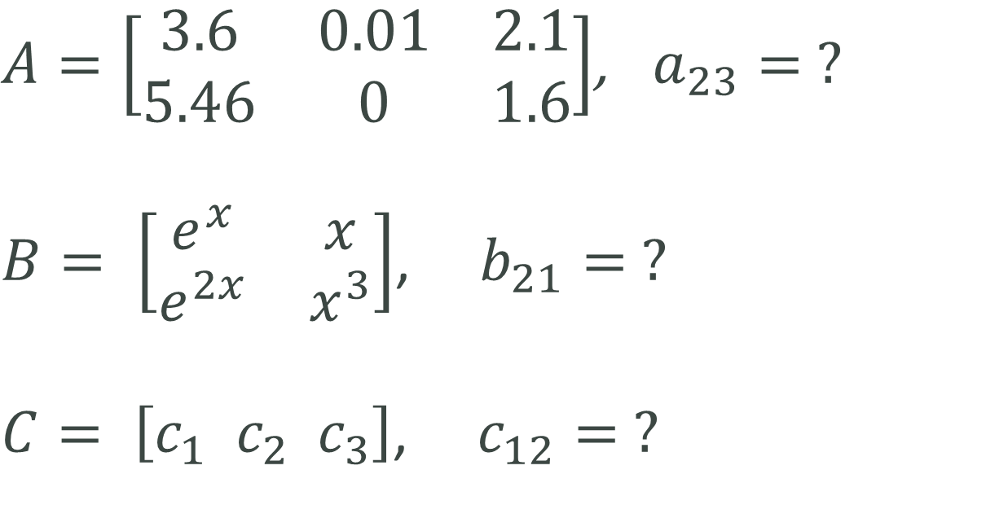
Examples
2. Find the listed element of each matrix?
$A=\left[\begin{matrix}3.6 & 0.01 & 2.1 \\ 5.46 & 0 & 1.6\end{matrix}\right]$, $a_{23}= ?$
$B= \left[\begin{matrix}e^{x} & x \\ e^{2x} & x^{3}\end{matrix}\right]$, $b_{21}= ?$
$C= \left[c_{1} c_{2} c_{3}\right]$, $c_{12}= ?$

Slide 7

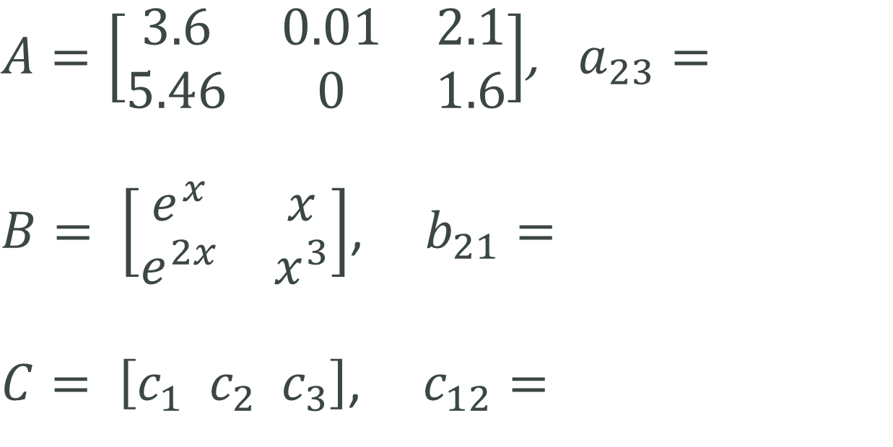


Examples
2. Find the listed element of each matrix.
$A=\left[\begin{matrix}3.6 & 0.01 & 2.1 \\ 5.46 & 0 & 1.6\end{matrix}\right]$, $a_{23}=$
$B= \left[\begin{matrix}e^{x} & x \\ e^{2x} & x^{3}\end{matrix}\right]$, $b_{21}=$
$C= \left[c_{1} c_{2} c_{3}\right]$, $c_{12}=$
$$1.6$$
$$e^{2x}$$
$$c_{2}$$

Slide 8
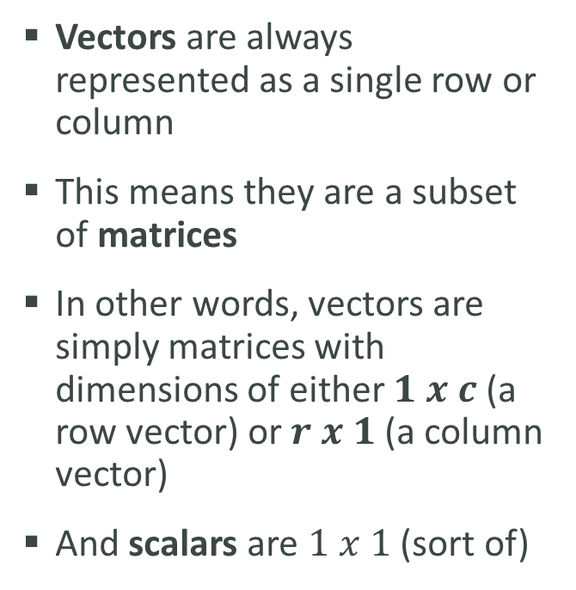
One more thought on dimensions
Vectors are always represented as a single row or column
This means they are a subset of matrices
In other words, vectors are simply matrices with dimensions of either $1 x c$ (a row vector) or $r x 1$ (a column vector)
And scalars are $1 x 1$ (sort of)
Matrix
r rows x c columns
Vector
1 row x c columns
Scalar
1 row x 1 column
r rows x 1 column

Slide 9
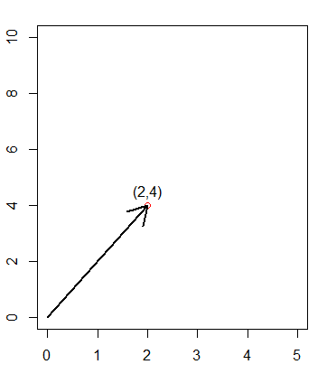
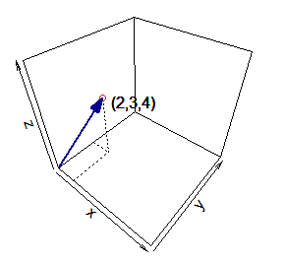



Vectors in space
Vectors are also used to represent a location in space. Each entry represents a dimension. This is easy to see in 1, 2, and 3 dimensions. Here are three vectors shown in n-space.
$$u = −3$$
$$v=\left[2 4\right]$$
$$w=\left[2 3 4\right]$$
-4 -3 -2 -1 0 1 2

